Slide 1




Team MATCHMAKING OVO
Duurzame samenwerking met Afrika

Slide 2
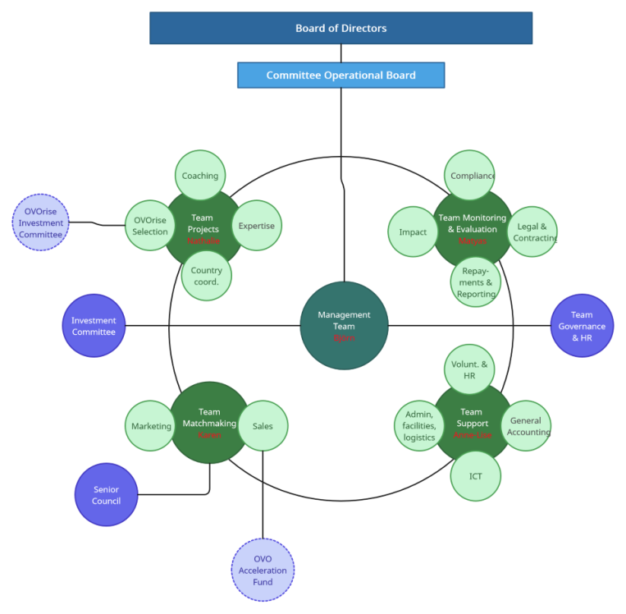

Slide 3

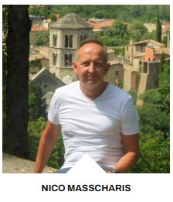
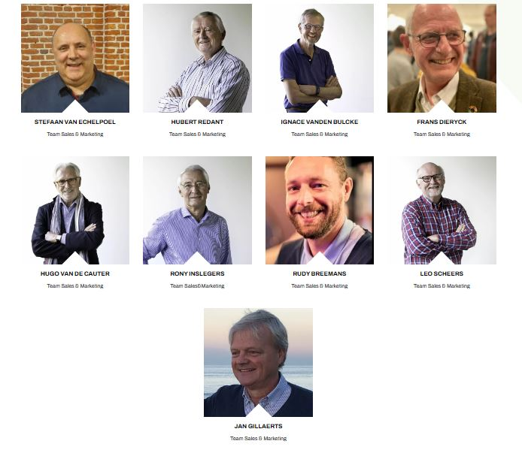
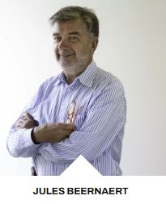
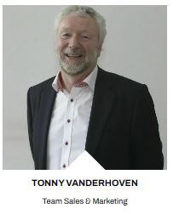
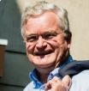
Team Matchmaking: WHO
Spectaculaire groei
van de bevolking in Afrika, veel groter dan de groei in tewerkstelling
Economische en
ecologische migratie neemt toe
You?
Bernard Paquot

Slide 4
Team Matchmaking: WHO
Team:
Karen Peersman
+
Volunteers:
Account Managers
New business manager
New business data miner
Marketing
Spectaculaire groei
van de bevolking in Afrika, veel groter dan de groei in tewerkstelling
Economische en
ecologische migratie neemt toe
Team meetings: +-every 2 months

Slide 5
Team Matchmaking: roles
Team Matchmaking hosts 2 cells:
2.3.1. Marketing
The prime objective of the Cell “Marketing” is to create, increase and sustain brand recognition and awareness of OVO and ST4A, targeted at an audience of European-based businesses and business organizations, Belgian government and related relevant institutions, investment funds, educational organizations. The Cell is also taking care of awareness creation in the general public in order to attract private investors and donors as well as volunteers to take up specific roles in the OVO network.
The Cell hosts 2 distinctive job roles:
Brand Manager who takes care of the overall creation, enhancement and management of the ST4Africa & OVO branding via marketing planning and budgeting.
Market Analyst which is a role focusing on data gathering and analysis regarding target groups and stakeholders. Its purpose is to feed insights in order to more effectively focus marketing and sales efforts.
2.3.2. Sales
The Cell “Sales” is in charge of acquiring, establishing and maintaining a network of funding sources, both structural and ad hoc, and, both to as well finance ST4Africa project investments and selected NGO projects as internal OVO operations via structural OVO partners and the OVO Acceleration Fund.
The Cell Sales pursues its objectives and targets via 3 distinctive job roles:
New Business Manager whose main objective is the acquisition of new partners and funding sources via prospection and active selling.
New Business Data Miner is a research role in support of new business development. The focus is on identifying target prospects or prospect groups in line with the commercial strategy and on preparing an identification file on selected prospects, including foundations and subsidies.
Account Manager whose main objective is to maintain and deepen relations with existing partners and sources of funds in order to guarantee continuity of funding. .

Slide 6
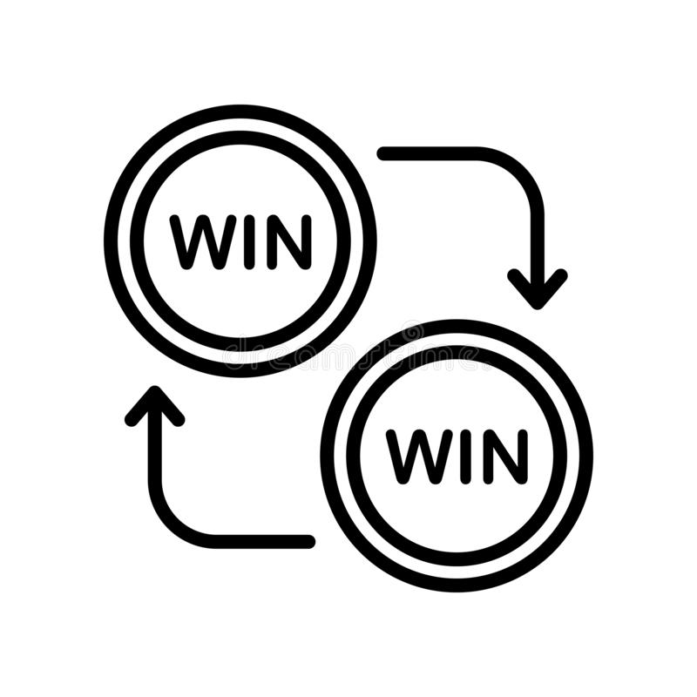
Team Matchmaking: WHAT
    What do we need money for?
      DONATIONS
        NGO projects
        OVO Operations
        OVO Acceleration Fund
      LOANS to B2B projects
Economische en
ecologische migratie neemt toe

Slide 7
Team Matchmaking: numbers
Economische en
ecologische migratie neemt toe

Slide 8
Team Matchmaking: targets 2024
Targets for Fundraising for projects in Africa:
Gifts for ngo projects: 650 000 EUR
Loans to African entrepreneurs: 400 000 EUR
Gifts to the OVO Acceleration Fund: 150 000 EUR
Donations to business projects (Klimpala): 120 000 EUR (already ok)
Economische en
ecologische migratie neemt toe

Slide 9
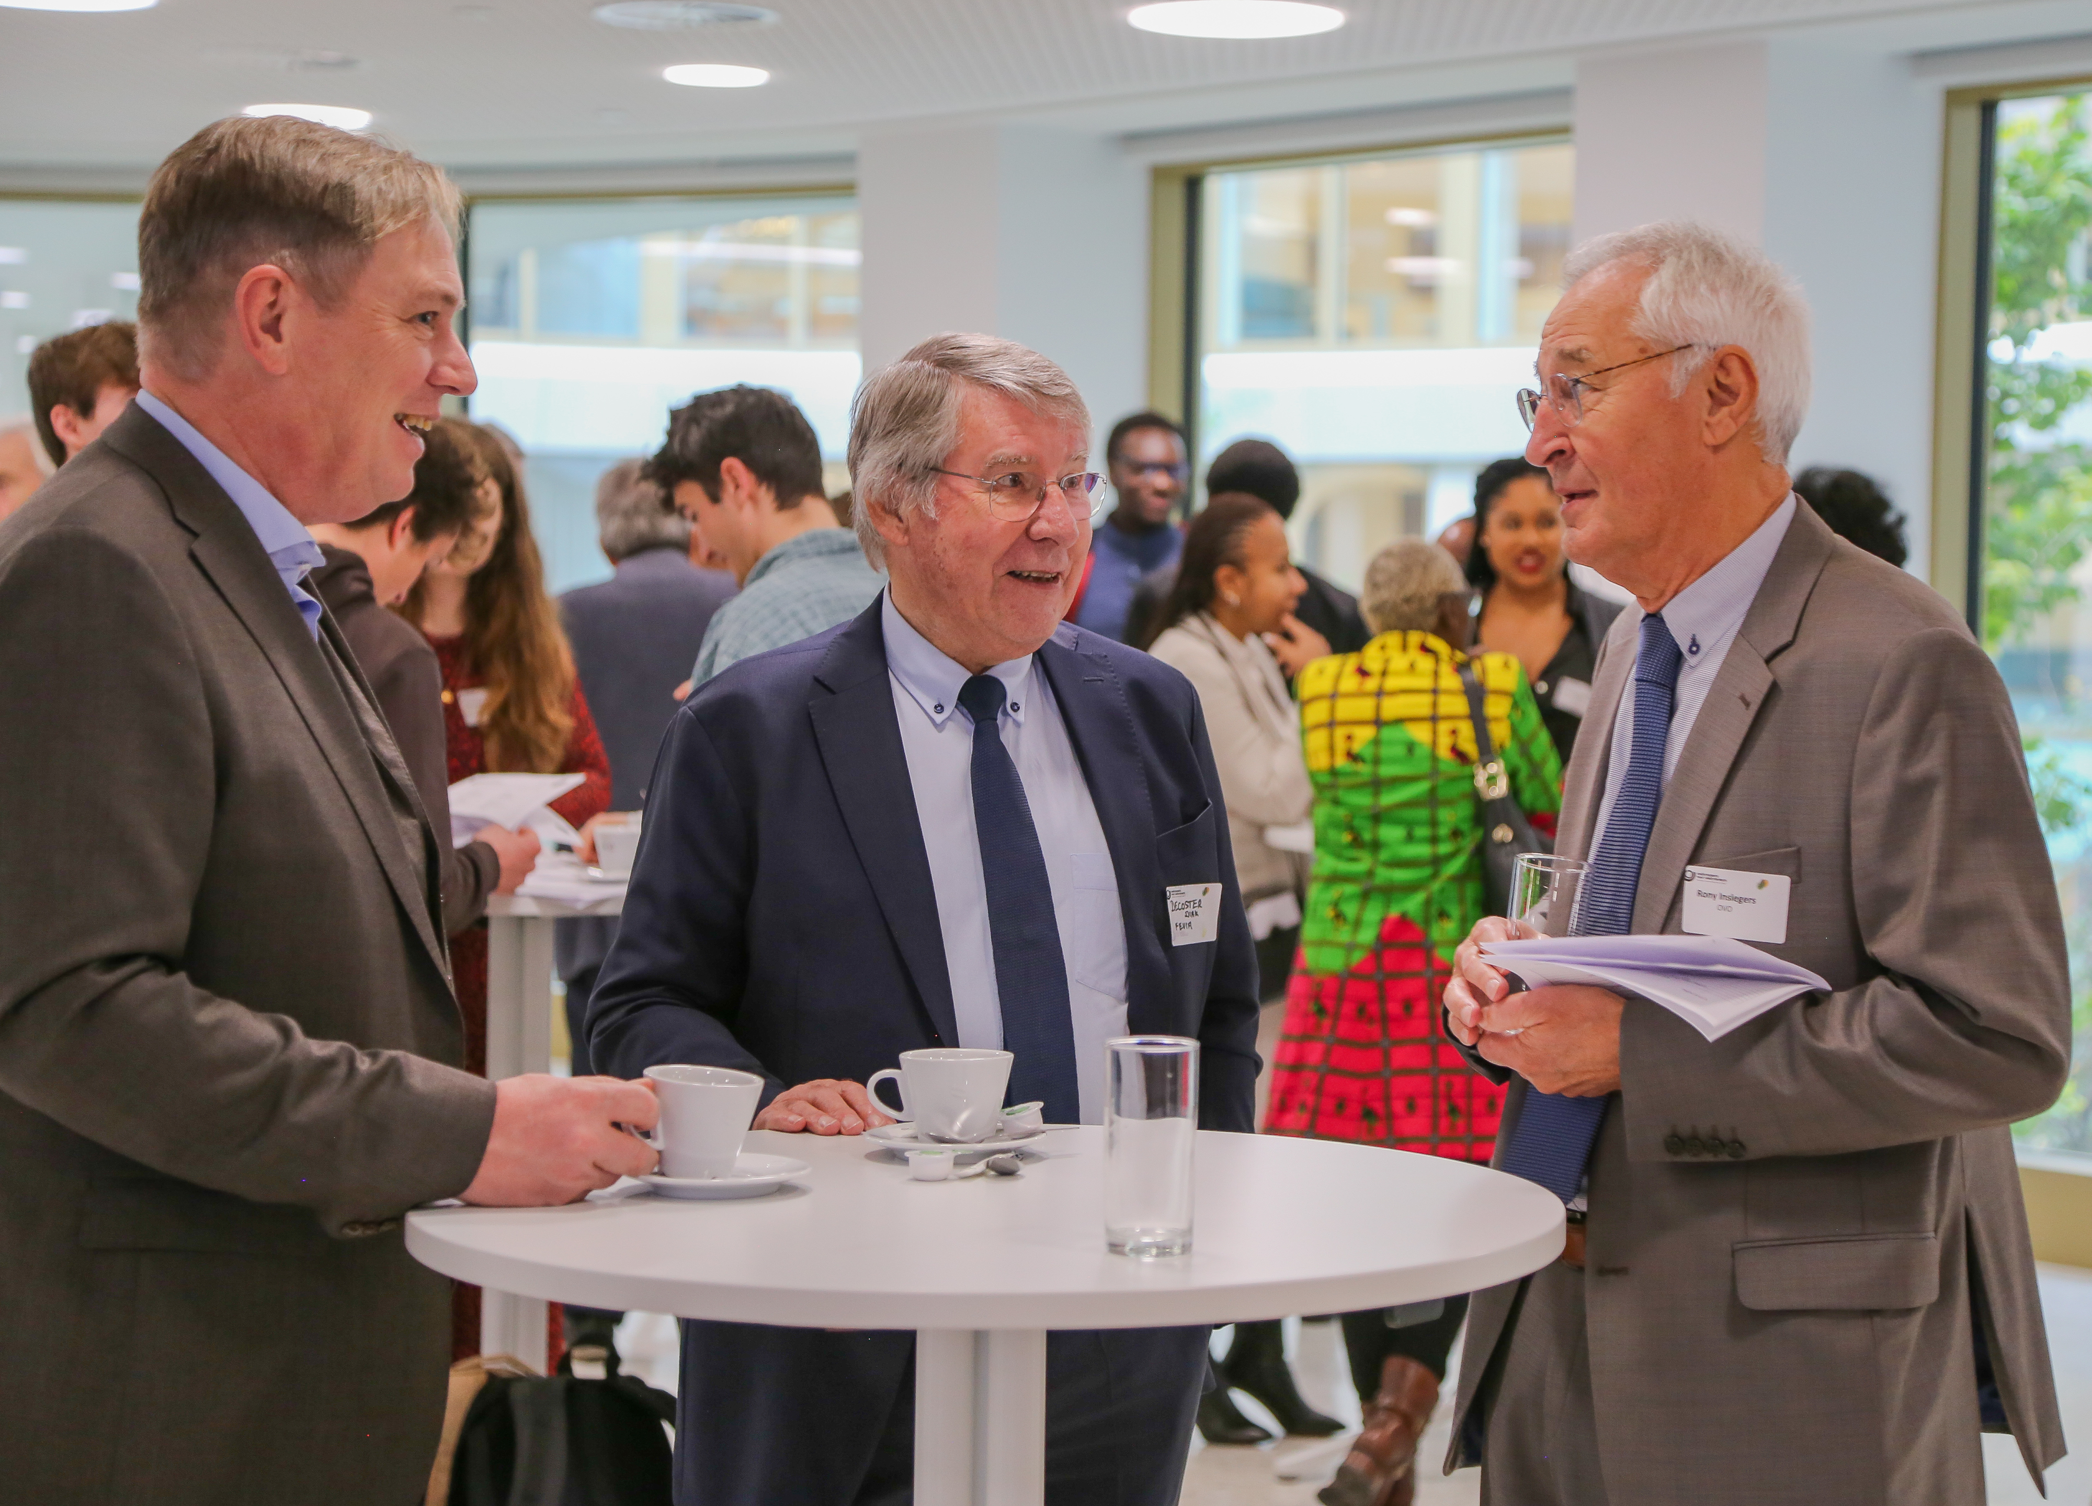
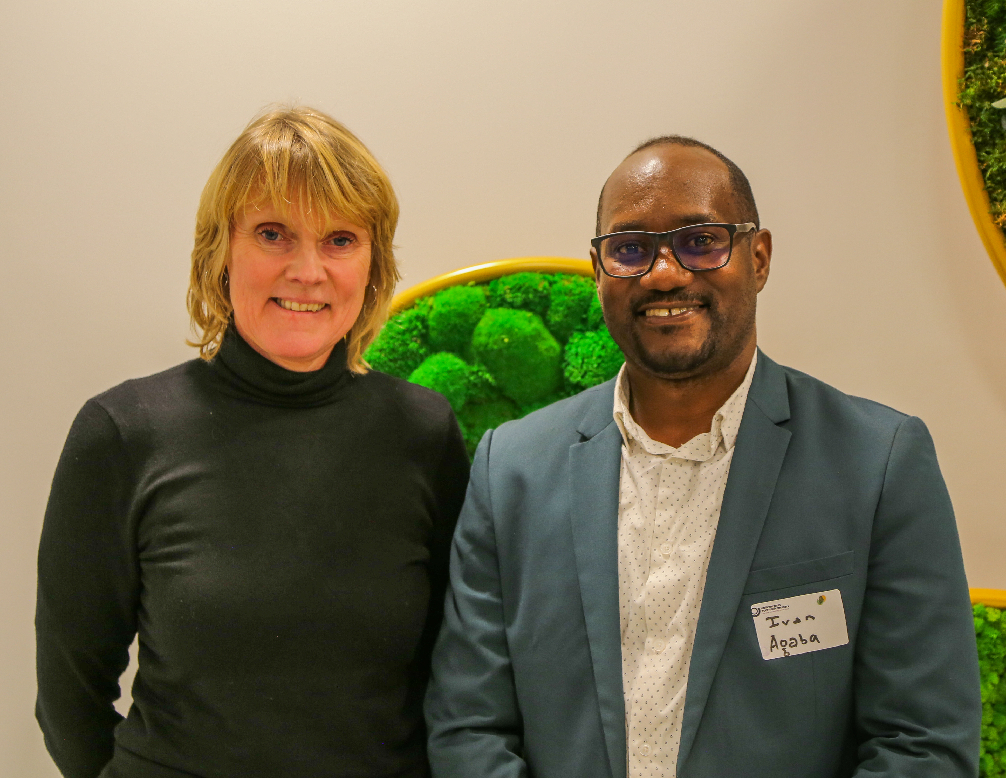
Team Matchmaking: target groups
Existing sponsors
Network of volunteers
Mailings – datamining
Foundations (Nathalie is responsible)
Trade Federations
HR departments (new volunteers)
Banks, Wealth Managers, Private bankers (OVO Acceleration Fund)
Rich families
Service Clubs
Impact Investors
Business Angels (BAN Flanders)
Investment clubs (like SIMIN)
Consulting (Enabel, IOM, Vito) - (Björn is responsible)
Economische en
ecologische migratie neemt toe

Slide 10
Team Matchmaking- fundraising
Datamining
Based on conversations and brainstorms, a list of companies we want to reach has been drawn up. This list is fed by, for example, companies that go on a princely mission to one of our focus countries, companies that are involved in sustainable entrepreneurship (voka charter sustainable entrepreneurship, B corp companies) and companies that are active in the sectors, countries, etc. where we have NGO projects.
In this list you can find if a company has already been contacted.
Stefaan (volunteer) and Nico (volunteer), together with interns, try to complete this list as much as possible.
Mailings are also sent out based on this list.
Team Sales & Marketing - 00. SALES FUNNEL - Alle documenten (sharepoint.com)
How do you use this list?
You download it on your own computer .
You go through the whole list to see if you have a contact or introduction somewhere
You make the selection with companies linked to your name to keep track of the actions that still need to be done
You mark changes in red, save them and mail the list as an attachment to Karen.
Economische en
ecologische migratie neemt toe

Slide 11
Team Matchmaking
Because the success rate in cold prospecting is low and time consuming, OVO prefers to use existing networks. To efficiently identify companies/managers you can use different channels:
Own (existing) network
Make an inventory of the people you could appeal to, or have a look at our sales funnel.
Do you have personal contacts with a manager?
Do you have inside support in certain companies (an HR manager or Sales Director who can introduce you to the manager or the CSR department)?
LinkedIn is an effective tool to explore your network
Ambassadors
Because of your background in business you may know someone who can introduce you to the right person. E.g.: Governor of your province, active manager, professional associations, ...
Again, LinkedIn is an effective tool to explore who can link you to a certain company and/or professional
Networking activities
OVO is connected to various networks such as VOKA, Etion ... Here you can make contacts with potential customers.
Economische en
ecologische migratie neemt toe

Slide 12
Team Matchmaking
why partner with OVO
CSR: You fill in your corporate social responsibility concretely and qualitatively
Engagement: You will have the opportunity to communicate and share your commitment with your employees and involve your staff in your project.
Image: CSR companies often score better with customers, partners, subsidy providers, donors, media, policy makers and investors, employees, etc.
Return: communication
Financial: tax deduction/fiscal attestation
Transparency: You work with a reliable and professional partner, we carefully select and assess projects and we take care of the reporting
Neutrality: OVO is an apolitical organization
Network: You join a unique and international network of like-minded companies, organizations and students, and you can participate in events.
Economische en
ecologische migratie neemt toe

Slide 13
Team Matchmaking:
Practical information return
Gift NGO: fiscal attestationd and report
Gift operations: fiscal attestation (to be confirmed)
Gift Acceleration Fund via KBS: fiscal attestation KBS and report
Membership fees: invoice (tax deduction for the company)
  The core membership (kernlidmaatshcap) is €7500 excl. Taxes . €5.500 is exempt from VAT. The remainder €2000 is subject to VAT(= €420). Total of the invoice is €7920.
Economische en
ecologische migratie neemt toe

Slide 14
Team Matchmaking:
Practical information return
FISCAL ATTESTATION
Entrepreneurs for Entrepreneurs (OVO) has been approved to issue tax attestations for donations starting at 40 euros/year from 2018 through 2023. (has to be renewed, we are waiting for a meeting for the evaluation, probably in march 2024)
A donation is a sum of money donated by a person, company or organization to a project of an NGO partner or the general operation, for which the donor receives nothing in return. A gift does entitle the donor to a tax certificate.
  ATTENTION: it is extremely important to monitor that there is never a quid pro quo or commercial benefit for the donation, for example mention on the website. If this is the case, no tax certificate can and may be issued.
For donations to the Acceleration Fund (Friends-of-fund at the King Baudouin Foundation), you are referred to the KBS website: Making a donation (kbs-frb.be). For these donations, a certificate is issued by the King Baudouin Foundation.
Economische en
ecologische migratie neemt toe

Slide 15
Team Matchmaking:
Practical information invoicing
  Please supply the following information when asking to invoice :
    The correct invoicing data:
      name of company or corporation (vennootschap)
      VAT number
      Invoicing address
      Contact data for the responsible for the accounting within the company (name, email address and telephone number)
      If someone else needs to receive the invoice, please stipulate ESpecifieke boekhoudkundige referentie of PO-nummer
    Specify whether it is a gift for an ngo project (projectcode) or a gift to the 'general fund' (algemeen fonds)
    Invoicing date
  For a donation to an ngo project, OVO sends out an 'invitation for payment', for membership fees, we send out an invoice
  Contacts for invoicing: Karen@ovo.be, Matyas@ovo.be
Economische en
ecologische migratie neemt toe

Slide 16
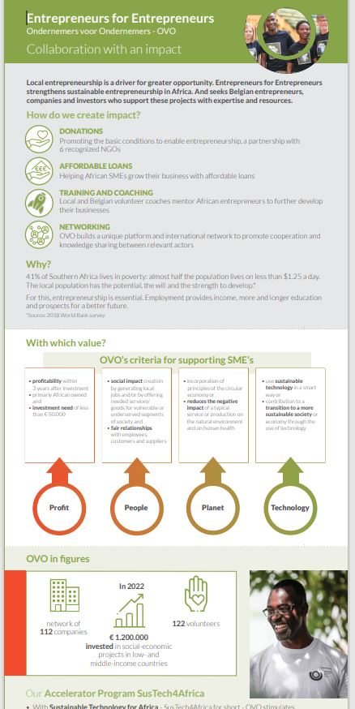
Team Matchmaking:
how do we present OVO
OVO Website
OVO PowerPoint Presentation (NL, FR, ENG) Team Sales & Marketing - 2.01 Powerpoints - Alle documenten (sharepoint.com)
Sales PortfolioTeam Sales & Marketing - Sales portefeuille - Alle documenten (sharepoint.com)
Folders Team Sales & Marketing - 2.02 Leafletfolder - Alle documenten (sharepoint.com)
  OVO general
  OVO impact
  OVO Acceleration Fund
  Volunteer recruitment
  Ambassador recruitment
Yearly report Team Sales & Marketing - 2.06 Jaarverslagen - Alle documenten (sharepoint.com)
Video's: Team Sales & Marketing - 2.05 Testimonials & videos - Alle documenten (sharepoint.com)
OVO intranet www.ovo.be/intranet
Economische en
ecologische migratie neemt toe

Slide 17
Team Matchmaking
Tips
If possible, try to get in contact with the CEO of a company, and/or CSR Manager
Family businesses
Look at a prospect's website: information about their CSR policy is very valuable, what SDG's are their priority, …
We always to try to find a WIN-WIN: how can a partnership with OVO be interesting for the donor, and explain what we are able to do with their donation. We try to encourage them to communicate about the partnership.
The end of the sales conversation
    A good conversation can be held, the right questions can be asked, the product is well presented, good questions asked... but if it comes down to 'rounding off the conversation' - 'close the deal', the boat is often missed.
    Make sure you leave with a concrete appointment: e.g. 'When can we start?‘, 'Do I need to talk to someone?‘
    Pretend the deal is already done
    The million dollar question: “What do you like most about our offer?”
    “How much chance do we have?” →The other party will answer e.g. x%. You can then respond by asking 'What do we have to do to make it 100%?
Economische en
ecologische migratie neemt toe

Slide 18
Team Matchmaking
When an entrepreneur shows interest in NGO projects,
  always first present the project portfolio. When choosing a project, carefully assess the company's expectations regarding feedback/reports/input for their communication and that these expectations are in proportion to the donation they want to make.
  If additional information about one or more projects is required, the consultant can provide the donor with the more detailed project sheets for the projects in question.
  If a company does not find what they are looking for in the sales portfolio, and they want to make a substantial donation (over 10 000 Euro), we can offer a tailor-made ngo project.
Economische en
ecologische migratie neemt toe

Slide 19
Team Matchmaking
Good to know
In February-April, we send out diplomas to our sponsors( "company stood for more than profit in 2023"), this is a good opportunity to ask your contact for a meeting and encourage them to communicate their engagement
The leverage effect for donations to NGO projects
  the majority of our NGO projects benefit from an advantageous system of cofinancing by the European Commission, the Belgian Fund for Food Security or Belgian Development Cooperation. This co-financing method creates a multiplier effect up to a maximum factor of 5 for projects where the co-financing system applies.
  Leverage Viafonds (social fund of the federation of the Belgian food industry Fevia, they add 0.75 euro for every euro donated by a food company)
OVO team:
  Responsible for communication (external newsletter, project sheets, …): Nathalie
  Responsible for reporting: Matyas
Economische en
ecologische migratie neemt toe

Slide 20
Team Matchmaking
OVO works with an investment committee that approves project before we go looking for financing:
  Ngo projects are in principle approved for a 5 year period and put in the sales portfolio
  B2B projects are submitted to a monthly independent IC and are assessed based on clear criteria. If a project is approved, we look for funding: the OVO Acceleration Fund invests in principle 50%, and for the remainder we try to find business angels
    To find investors or business angels it is important to know that we are limited in our communication, it is not admitted to do a mailing to all our contacts or to put it on our website (FMSA). We have a list of people who are interested in investing and we send the list to them. If we want to spread the investment opportunity to other parties, we have to make it 'anonymous', so without the name of the project
    If all the investors have been found, Matyas draws up the contracts, once this is signed by all parties, he sends out an invitation for investors to transfer the amount to OVO. The money is only transferred to the entrepreneur after they have paid the OVO fee of 1%.
    Matyas follows up the reimbursements and informs the investors periodically
Economische en
ecologische migratie neemt toe

Slide 21
Team Matchmaking:
Volunteering at OVO
  Please check the intranet www.ovo.be/intranet for general information (history of OVO, insurance, expenses) about volunteering @OVO: Vrijwilligerswerk bij OVO (ondernemersvoorondernemers.be)
  People you know who are interested in volunteering at OVO, contact anne-lise@ovo.be, Anne-Lise and our colleague volunteer Rita will guide them through the onboarding process
Economische en
ecologische migratie neemt toe

Slide 22
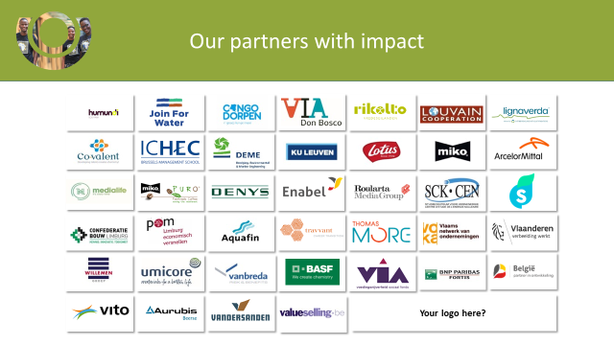

Slide 23
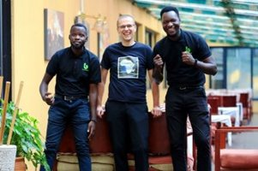

Join us!
Karen Peersman
Manager Northern Operations
karen@ovo.be
www.ovo.be

