Slide 1




Sustainable cooperation with Africa

Slide 2

Entrepreneurs make the difference
Spectacular
population growth in Africa, much faster than employment growth
Africa is heavily exposed to the effects of climate change
Encourage entrepreneurship to provide opportunities for everyone in their own region
Investing in sustainable entrepreneurship
in Africa ​
Economic and ecological migration on the rise

Slide 3
De missie van OVO
OVO’s mission statement
OVO strengthens sustainable entrepreneurship in Africa
We see local entrepreneurship as an engine for increased opportunities
We select, coach, finance and monitor African businesses and projects to help them achieve their goals
We actively build an international network of partners, experts and organizations that share the same goal

Slide 4

An independent network organization
with an entrepreneurial mindset
Employees
(in Belgium and Africa)
NGO's
Volunteers
(in Belgium
and Africa)
King Baudouin Foundation
Investors and donors (in Belgium and Africa)
Public authorities
(in Belgium and Africa)
Sponsors
(in Belgium and Africa)
Diaspora
Partner organisations: Enabel, IOM, Einstein Rising, ... (in Belgium and Africa)
Educational institutions
(in Belgium and Africa)

Slide 5
How we create impact
DONATIONS
Promoting the basic conditions to enable entrepreneurship, a partnership with 6 recognized NGOs
AFFORDABLE
LOANS
Helping SME's grow with social loans
Focus countries: Uganda, Rwanda, Senegal and Benin
EXPERTISE
Coaching, mentoring and knowledge exchange

Slide 6
SusTech4Africa: acceleratorprogramma met een uneke aanpak door intergenerationele & interculturele samenwerking
SusTech4Africa: accelerator program with a unique approach
by intergenerational & intercultural cooperation
AFRICAN
DURABLE ENTREPRENEURS
BELGIAN
EXPERTS
Propose projects that grow from local needs and add social value
Bring entrepreneurial experience and technical expertise to make the project stronger and investment-ready
BELGIAN & AFRICAN
STUDENTS
LOCAL
EXPERTS
Add alternative perspectives, new techniques, innovation and dynamism
Bring knowledge of the local context and have
face-to-face interactions with the entrepreneur
Allows knowledge to be shared quickly
and efficiently, to learn from each other and to increase synergy
Notes:
African companies too big for microfinance,
Too small for impact investing, and
Not yet able to access mainstream finance
lack of formality,
no track record of several years,
high interest rates and collateral,
etc.
With a high growth potential and social impact!
SusTech4Africa: selectieprocedure
OVO AF: rollend fonds, giften

Slide 7



OVO Acceleration Fund
OVO Acceleration Fund = revolving loan fund for sustainable business projects
The OVO Acceleration Fund manages contributions from individuals and companies
We transform your donation into an affordable loan
Once it has been reimbursed, the money (with interest) comes back into the fund and made available to other Afropreneurs =
  SME’s can take out a loan of up to € 50.000 (interest rate of 7%, 1 to 5 years)
  Max 50% from the fund
  Co-investment by business angels

Slide 8




Our strengths
Sustainable economic projects with social impact: a differentiated project portfolio
A very extensive network of like-minded people
Access to expertise to stimulate creativity and knowledge transfer
A professional team supported by experienced volunteers

Slide 9

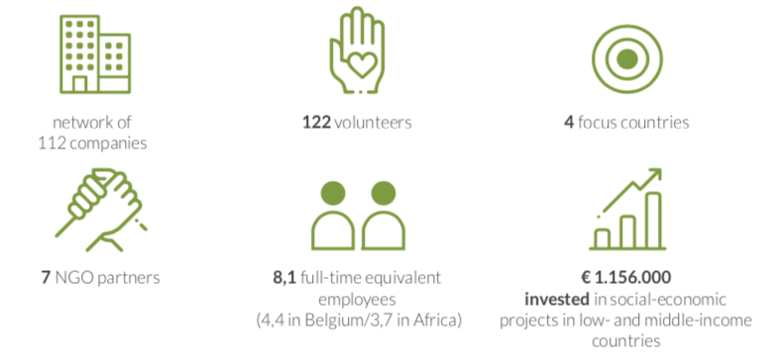
Our impact in figures – 2022

Slide 10
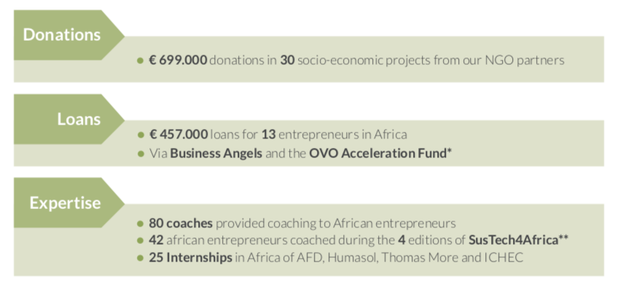
Our impact in figures – 2022
Donations: 2014 – 2022 : €7.023.000 donations to projects of our NGO partners
Loans: 2014 – 2022 : €2.057.000 invested in 66 SME's financed with funds from 100 Belgian business angels

Slide 11
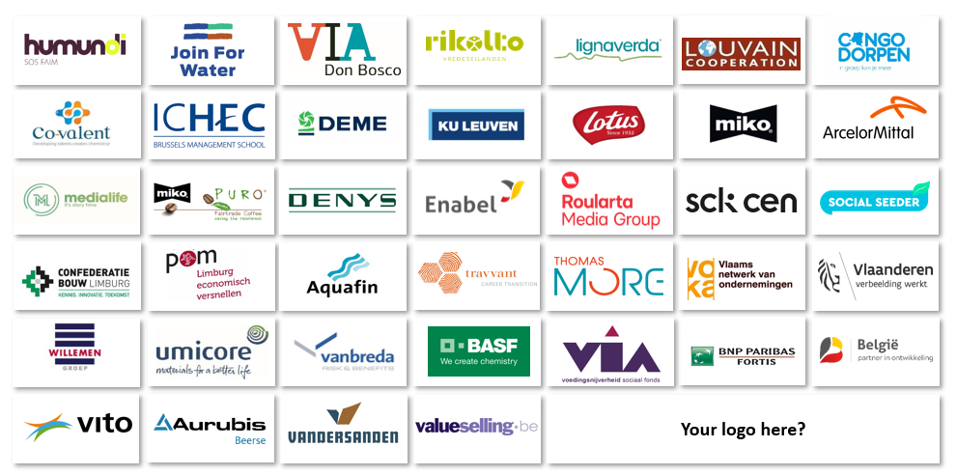
Our partners with impact

Slide 12
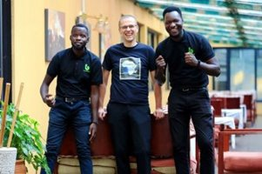

Join us!
Karen Peersman
Manager Northern Operations
karen@ovo.be
www.ovo.be

