Slide 1
Entrepreneurs for Entrepreneurs
Team X

Slide 2
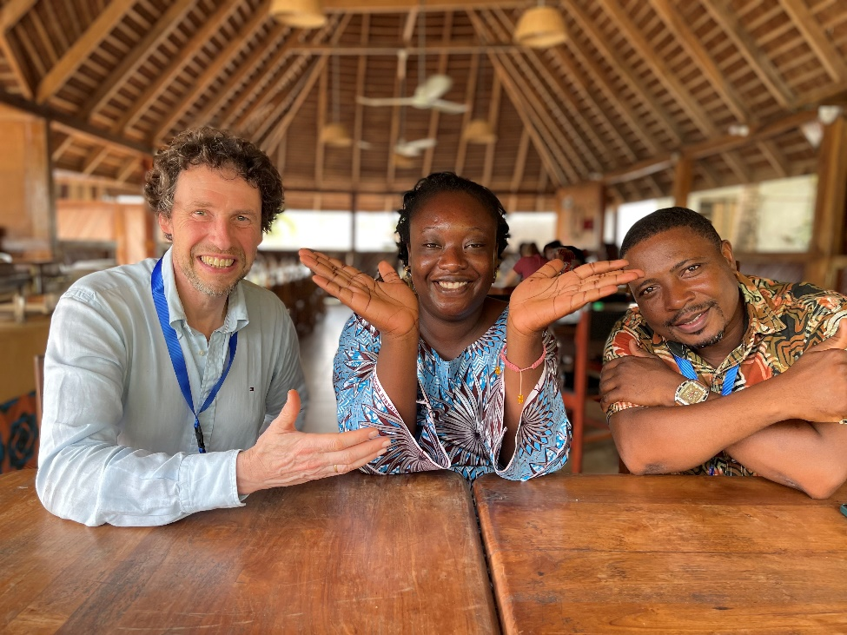
Invest in sustainable entrepreneurship in Africa
www.ovo.be

