Slide 1
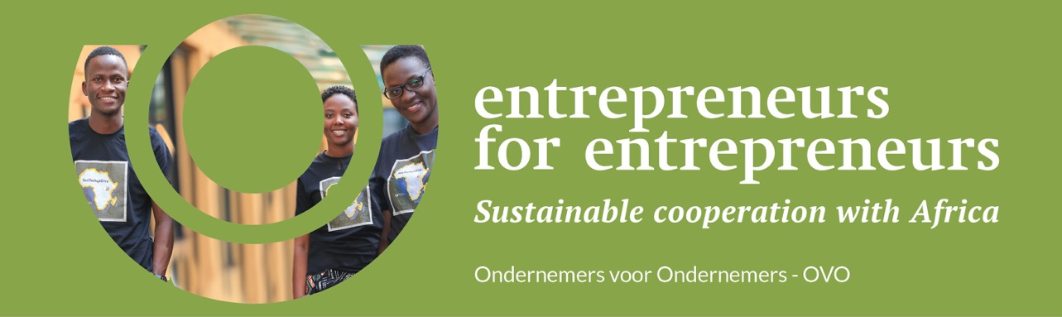


Slide 2


High Potential for Business Opportunities
Economic Growth – In recent years, Africa’s economic growth rate has been consistently outpacing the global average
Emerging Middle Class – By 2025 Africa’s consumer spending is projected to reach $2.1 trillion
Entrepreneurial Spirit – Africa has the highest rate of entrepreneurship globally
Youthful Population – Africa has a young and growing population, with a median age of around 20 years old
*source: African Development bank **source: Brookings Institution ***source: Statista

Slide 3
Challenge
There is a lack of tailored support available for African SMEs to grow and prosper
Many African SMEs lack the business knowledge necessary to scale up and be succesful
African SMEs struggle to obtain affordable loans
Notes:
Difficult access to loans + if they can get a loan, it is not affordable

Slide 4
Solution
OVO supports African SME’s through:
  Training and one-on-one coaching by Belgian OVO experts to come to a realistic yet ambitious business plan
  Affordable tailor-made loans via the OVO Acceleration Fund : entrepreneurs can borrow up to €50,000
Notes:
Tailer-made: we are flexible in terms of collateral, grace period, payback term…

Slide 5
Modus operandi: criteria
The OVO Acceleration Fund provides tailor-made loans to investment ready African SME’s
OVO Acceleration Fund only invests in companies selected by OVO
OVO provides due diligence, coaching and monitoring throughout the process
Project selection criteria:
  Approved business and financial plan
  Positive SDG assessment
  Economically, environmentally and socially sustainable
  Positive assessment of the managerial potential of the team, ambition, job creation
  Innovation and use of sustainable technology

Slide 6

Business model
The OVO Acceleration Fund manages contributions from individuals and companies
We transform your donation into an affordable loan.
Once it has been reimbursed, the money (with interest) comes back into the fund and made available to other Afropreneurs =
  SME’s can take out a loan from the fund of up to € 50.000 (interest rate of 7%, 1 to 5 years)
  Max 50% financed by the fund
  Co-investment by business angels

Slide 7

Impact so far in August 23
Founded in 2019 with the support of King Boudewijn Foundation
Since 2019:
330,000 invested by Acceleration Fund
30+ entrepreneurs with a loan
Our goal > 2025: € 500,000 Acceleration Fund Investments/ year
Notes:
van die 2,5 M invested werd 330K door het AF gefinancierd (en dit pas sinds 2018 wanneer het fonds werd opgericht, ervoor werden projecten enkel door business angels gefinancierd), de rest door business angels

Slide 8






De missie van OVO
What’s in it for your company ?
Together, we can tackle the 2030 Agenda for Sustainable Development, adopted by all UN member states
For your donation you get:
OVO’s proven expertise acting like a matchmaker between you and investment-ready Afropreneurs
Tax certificate for your donation
Continued impact: your donation replenishes the fund, which then supports another entrepreneur who pays back the loan to the fund, which then supports a new entrepreneur, and so on
Transparent communication about the concrete achievements, and the financial picture

Slide 9
Management OVO Acceleration Fund
  Managed by Ondernemers voor Ondernemers (OVO)
  Founded by Fons Verplaetse ( National Bank governor) in 2000
  First direct investment in African entrepreneurs in 2013
    2013-2023: 164 entrepreneurs coached, 80 sustainable businesses received loans, totalling €2.5 M
    5 projects defaulted
    15 loans fully repaid
  Professional core team in Belgium and Africa (8,1 FTE)
  Supported by 120+ volunteers and 110+ Belgian companies
  Operational in Benin, Senegal, Rwanda and Uganda

Slide 10

An independent network organisation
with an entrepreneurial mindset
An independent network organisation
with an entrepreneurial mindset
Employees (in Belgium and in Africa)
NGO's
Volunteers (in Belgium
and in Africa)
King Baudouin Foundation
Public authorities
(in Belgium and in Africa)
Investors and donors (in Belgium and in Africa)
Sponsors
(in Belgium and in Africa)
Diaspora
Partner organisations: Enabel, IOM, Einstein Rising, ... (in Belgium and in Africa)
Educational institutions (in Belgium and Africa)

Slide 11







































Our partners with impact
Your logo here?

Slide 12
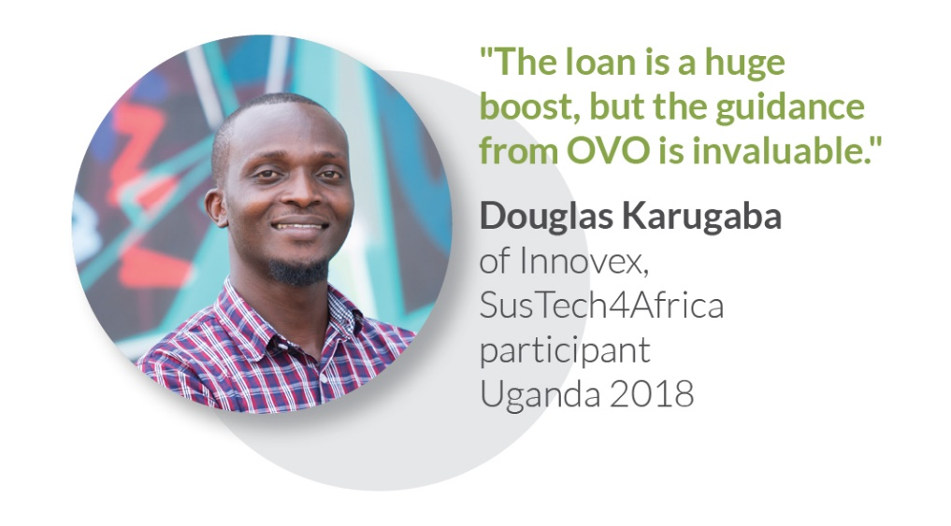
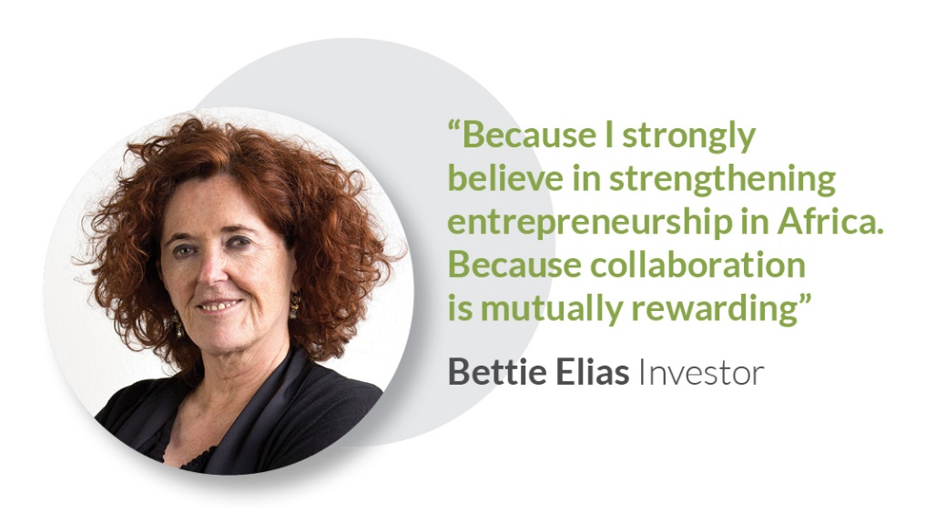
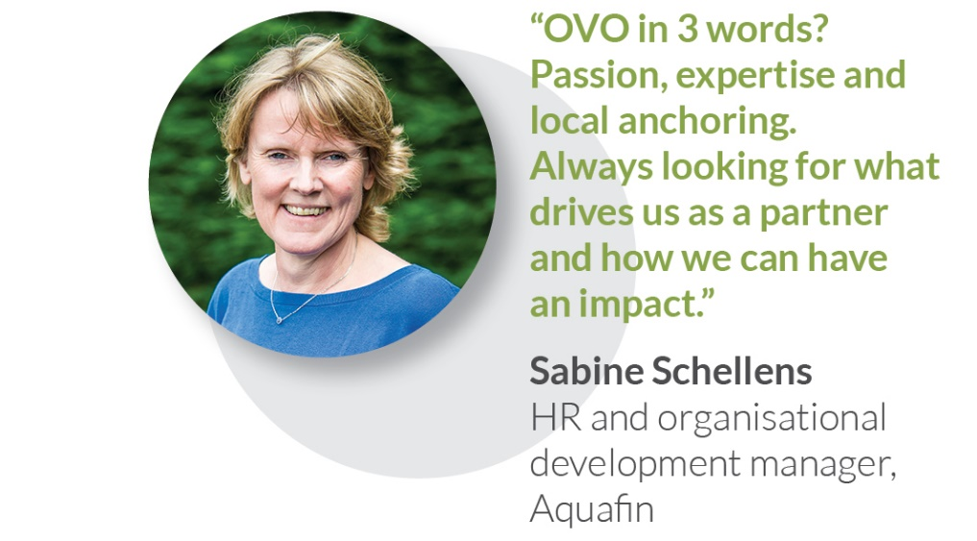
Together, we go the extra mile

Slide 13

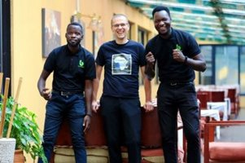
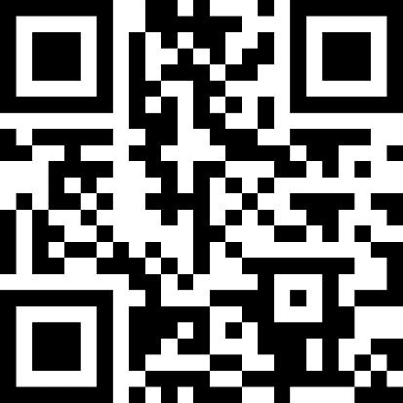
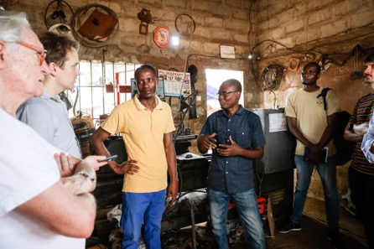

Join us!
WWW.OVO.BE
OVO in 3 minutes
Karen Peersman
Manager Northern Operations
+32 479 912 914
Karen.peersman@ovo.be

