Slide 1


Training: How to Use and Fill new Financial Plan v02.10
Presented by : Jean BEKA
Date : 02/11/2025

Slide 2

Agenda
Introduction
  Objectives of the training
  Prerequisite
  Overview of the financial Plan
  Step for completing the Financial Plan
  And the result is ….
Excel Version and File Settings
Excel Financial Plans Tabs
  Step-by-step guidance through the plan
  FAQ
Plan Validation and Review
Q&A
Notes:
This training session is designed to equip participants with the knowledge and skills necessary to effectively use and fill out an Excel financial plan. The objectives include understanding the structure of the financial plan, learning how to input data correctly, avoiding common mistakes, interpreting financial outputs, and utilizing the plan for strategic decision-making and reporting. By the end of the session, participants should be able to confidently navigate the tool, input relevant financial data, and extract meaningful insights to support their business or project planning.

Slide 3
Introduction
Notes:
Objectives of the Training, Overview of the Financial Plan

Slide 4
Objectives of the Training
Understand Financial Plan Structure
  Learn the components and layout of the Financial Plan for better navigation and use of the file.
Data Input Accuracy
  Master correct input techniques to avoid common errors and ensure reliable financial data.
Interpret Financial Outputs
  Develop skills to analyse and understand financial outputs to support informed decision-making.
Utilize for Strategic Decisions
  Use the Financial Plan insights for strategic reporting and business planning.
Notes:
This training session is designed to equip participants with the knowledge and skills necessary to effectively use and fill out an Excel financial plan. The objectives include understanding the structure of the financial plan, learning how to input data correctly, avoiding common mistakes, interpreting financial outputs, and utilizing the plan for strategic decision-making and reporting. By the end of the session, participants should be able to confidently navigate the tool, input relevant financial data, and extract meaningful insights to support their business or project planning.

Slide 5

Prerequisite
No Input Generation
  The Financial Plan does not generate inputs. It only organizes and calculates based on them.
  Some inputs must be prepared up front before filling the Financial Plan.
You should collect some basic information about
    🧾 Historical Financials
    🛍️ Product
    🧑‍💼 Service
    📊 Revenue
    🛠️ Operational Costs
    👥 HR & Payroll Plans
    💰 Investment & Funding Info
  Understanding the past empowers you to shape the future. Your current data serves as a foundation for forecasting what lies ahead.

Slide 6
Overview of the Financial Plan
10 tabs in the file → 3 tabs to complete
Tab | Content | Tab | Content
ReadMe | Workbook content Set your language | Instructions Tab | Detailed information per sheet
Inputs Tab | Yellow cells in yellow sheets to be filled | Reporting Tab | Click on “Refresh All Pivots” to get all green sheets updated
InputsData | Defines key parameters driving the financial model (currency, period, products and services, VAT, tax regime, best/worse case) | RevenuePivot RevenueChart | Predefined PivotTables and Charts about your revenue plan
RevenueData | Define your revenue plan (volume, price, COGS) per product and/or service | FinancePivot FinanceChart | Predefined PivotTables and Charts about your P&L, Balance Sheet, Ratios, Operating Expenses, Staff, Cash Flow Statment
FinanceData | Define your operating expenses, investments, working capital and source of financing | FinanceEUR | Summary sheet in EUR for investors

Slide 7
Steps for completing the Financial Plan
ReadMe sheet
    Set your language.
  Instructions sheet
    Read instructions sheet or slides here below (section Excel Financial Plan Tabs).
InputsData sheet
    Fill the yellow cells : country, year, product and services, range and distribution channel, staff, loan and simulation related information.
RevenueData sheet
    Fill the yellow cells : unit selling price, unit COG, quantity per quarter or per year (from YEAR3).
    OPTIONAL __ Fill the yellow cells : unit selling price per range, unit COGS per range, mix volume per range %, mix volume per channel %.
    Click on “Refresh All Pivots” to get all green sheets updated.
FinanceData sheet
    Fill the yellow cells of sections 2 to 7.
    Click on “Refresh All Pivots” to get all green sheets updated.
    OPTIONAL __ Select best- and worst-case scenarios and click on “Refresh All Pivots” to get all green sheets updated.
  Instructions sheet
    Check if no error : see note 16. If all TRUE, you are done.

Slide 8

And the result is...

Slide 9
And the result is…

Slide 10

Thank You
Enjoy the spreadsheet.
Don’t worry.

Slide 11
Excel Version and File Settings

Slide 12
Step 0 – About Excel version
Microsoft 365 online doesn’t support macros.
To use the Financial Plan, you must use a desktop version. Preferably a recent one.
EXCEL 2010 works almost fine, but you cannot open the hidden columns.
EXCEL 2016 works almost fine, but you may be missing some features.
EXCEL 2020 works fine. No problem was reported at this point.
EXCEL 2025 is recommended.

Slide 13
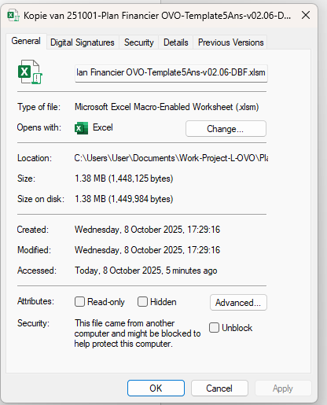
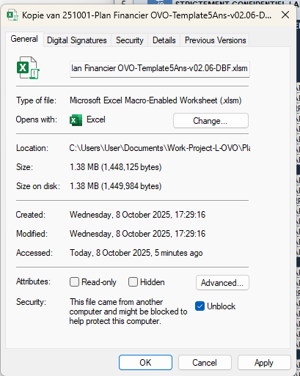
Step 1 – Before to Open the file
When you download a file from internet, intranet or save it from your mailbox, EXCEL may claim some security risks, as you downloaded the file from another source, and you are using macros.
Please follow instructions here below (step 1 and step 2).
Right click the file and choose Properties from the context menu
At the bottom of the General tab, select the Unblock checkbox and select Apply
Financier OVO-Template5Ans-v02.10-EMPTY.xlsm
Financier OVO-Template5Ans-v02.10-EMPTY.xlsm

Slide 14
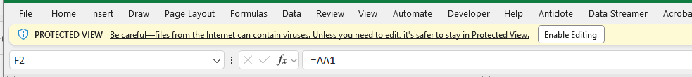
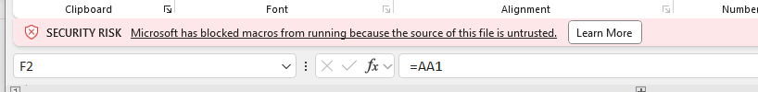
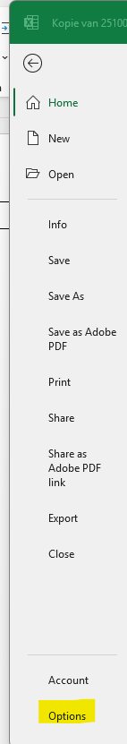
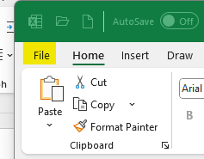
Step 2 – Open the file (1/2)
Click on Enable Editing
If you get this, it means that you have not done step 1. Close the file and proceed with STEP 1.
Otherwise, please continue with following instructions:
Go to File Options

Slide 15
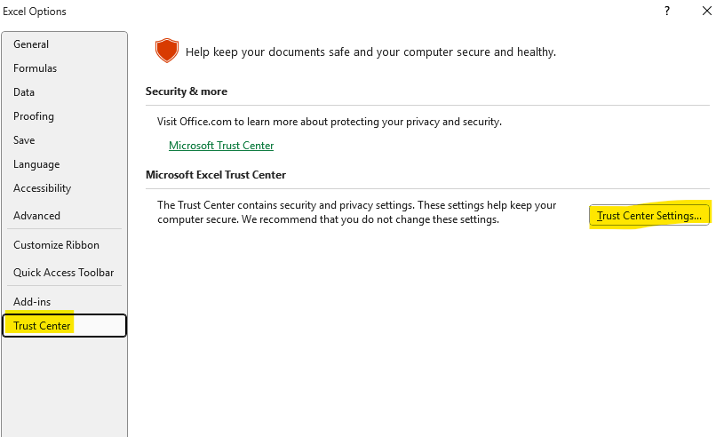
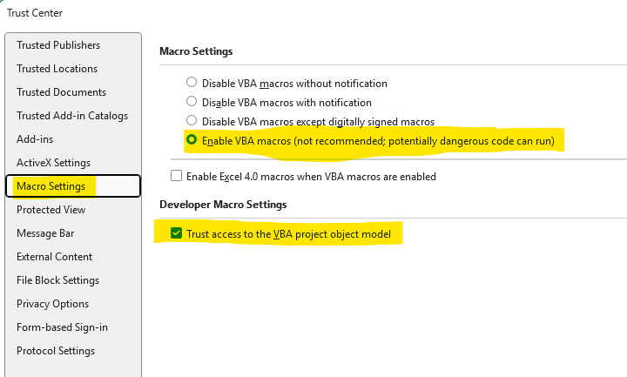
Step 2 – Open the file (2/2)
Select Trust Center (left column)
Select Trust Center Settings
Select Macro Settings (left column)
Enable VBA macros
Click the Trust access to VBA project
You are done. Enjoy.

Slide 16
Excel Financial Plan Tabs

Slide 17

InputData Tab (1/7)
Fill the yellow cells
  Company name
  Company country (Dropbox)
  CURRENCY
    Local currency
    Exchange rate local currency versus euro
    Exchange rate conversion date
  VAT
    In the VALUE column, enter the percentage of VAT applicable in your country for your activity.
  INFLATION
    In the VALUE column, enter the estimated percentage of INFLATION you may expect in your country.
  TAX REGIME
    In the FREE TEXT columns, you may provide a short text description of the tax regime and the conditions of the tax regime.
    In VALUE column, set the % of tax, you may expect. You may have different regimes based on your revenue level or net earning before tax level.
    You may skip these entries related to tax regime till a later stage and come back to it after you have constructed your profit & loss statement.
TIP
You may use cell D3 (“SECTION”) to filter section or use the keyboard arrow up and down in column B to navigate from one section to the next one iso scrolling the document
Notes:
The InputsData tab is the foundation of the financial model, where key parameters such as exchange rates, inflation, and growth rates are defined. These inputs drive calculations across other tabs. Users should fill in realistic and well-documented values. Accurate assumptions ensure the reliability of the entire financial plan.

Slide 18
InputData Tab (2/7)
Fill the yellow cells
  Enter in YEAR-2, the current year minus 2
    When we are in 2025, you should set YEAR-2 to 2023
    When we are in 2026, you should set YEAR-2 to 2024
  Enter in CURRENT YEAR H1 “ACTUAL” if you have the actual figures of the first half of the year, Otherwise, enter “FORECAST”
Notes:
The InputsData tab is the foundation of the financial model, where key parameters such as exchange rates, inflation, and growth rates are defined. These inputs drive calculations across other tabs. Users should fill in realistic and well-documented values. Accurate assumptions ensure the reliability of the entire financial plan.

Slide 19
InputData Tab (3/7)
Fill the yellow cells
  Products and services
    20 entries maximum for products and 10 entries maximum for services.
    In the PRODUCT NAME column, enter the (nick) name of your product or service. Maximum 25 characters each.
    In the FILTER column (Dropbox cell), set the value to 1 if you for these products or services you want to use in your revenue projection. Otherwise, leave it to 0.
    In the FREE TEXT DESCRIPTION column (optional), you may provide a short free text description of your product or services.
Notes:
The InputsData tab is the foundation of the financial model, where key parameters such as exchange rates, inflation, and growth rates are defined. These inputs drive calculations across other tabs. Users should fill in realistic and well-documented values. Accurate assumptions ensure the reliability of the entire financial plan.

Slide 20
InputData Tab (4/7)
Fill the yellow cells
  Range and distribution channels : optional
    In the RANGE NAME and DISTRIBUTION CHANNEL NAME columns, enter the (nick) name of your products and services range or distribution channel. Maximum 25 characters each.
    In the FREE TEXT DESCRIPTION column (optional), you may provide a short free text description of your products or services range or distribution channel.
    In the RANGE 1, RANGE 2 and RANGE 3 columns (Dropbox cell), set the value to 1 if you plan to forecast these products or services in multiples ranges. Otherwise, set the value to 1 in RANGE 1 column and leave it to 0 in RANGE 2 and RANGE 3 columns.
    In the DISTRIBUTION CHANNEL 1, DISTRIBUTION CHANNEL 2 columns (Dropbox cell), set the value to 1 if you plan to forecast these products or services in multiples distribution channels. Otherwise, set the value to 1 in DISTRIBUTION CHANNEL 1 column and leave it to 0 in DISTRIBUTION CHANNEL 2 column.
Notes:
The InputsData tab is the foundation of the financial model, where key parameters such as exchange rates, inflation, and growth rates are defined. These inputs drive calculations across other tabs. Users should fill in realistic and well-documented values. Accurate assumptions ensure the reliability of the entire financial plan.

Slide 21
InputData Tab (5/7)
Fill the yellow cells
  Staffing Category
    10 entries maximum for your staffing.
    In the OCCUPATIONAL CATEGORY column, specify if TEMPORARY or EMPLOYE staff.
    In the DEPARTMENT NAME column, enter the different department you may have today, or you project to have in the future within the company.
    In the SOCIAL SECURITY column, specify the % of social security versus the gross salary you pay.
Notes:
The InputsData tab is the foundation of the financial model, where key parameters such as exchange rates, inflation, and growth rates are defined. These inputs drive calculations across other tabs. Users should fill in realistic and well-documented values. Accurate assumptions ensure the reliability of the entire financial plan.

Slide 22
InputData Tab (6/7)
Fill the yellow cells
  LOAN
    In the YEARLY INTEREST column, enter the yearly loan interest rate.
    In the PAID BACK PERIOD column, enter the loan paid back period in years.
Notes:
The InputsData tab is the foundation of the financial model, where key parameters such as exchange rates, inflation, and growth rates are defined. These inputs drive calculations across other tabs. Users should fill in realistic and well-documented values. Accurate assumptions ensure the reliability of the entire financial plan.

Slide 23
InputData Tab (7/7)
Fill the yellow cells
  TYPICAL CASE
    In the next tabs, all inputs are considered as typical case.
  WORST CASE and BEST CASE scenarios optional
    You may be interested to see negative or positive variation impact of some inputs in your overall result.
    In the BEST CASE column, enter the percentage of variation for a best case scenario
    In the WORST CASE column, enter the percentage of variation for a worst case scenario
    You may skip these entries related to best case and worst case scenario to a later stage. You should first focus on your typical scenario.
Notes:
The InputsData tab is the foundation of the financial model, where key parameters such as exchange rates, inflation, and growth rates are defined. These inputs drive calculations across other tabs. Users should fill in realistic and well-documented values. Accurate assumptions ensure the reliability of the entire financial plan.

Slide 24

RevenueData Tab (1/4)
ONE PRODUCT - ONE RANGE - ONE CHANNEL DISTRIBUTION
Product and Services Inputs Gathering
  You should gather price, cost and quantity and per product and service
  Gross Profit Margin = (Price – Cost ) / Price
  Historical data and market benchmarks help guide realistic price and cost estimates and projections
  You have defined your product and service name in the InputData sheet
Fill the yellow cells
  SELLING PRICE column
    Price per product or service
  MIX VOLUME column
    Set to 100 %
  COGS column
    Price per product or service
  QUARTER 1, QUARTER 2, QUARTER 3, QUARTER 4, TOTAL YEAR columns
    Volume per quarter for YEAR-2 to YEAR2
    Volume per YEAR for YEAR3 to YEAR6

Slide 25
RevenueData Tab (2/4)
ONE PRODUCT - THREE RANGES - TWO CHANNELS DISTRIBUTION !!!!!!! OPTIONAL !!!!!!!
Fill the yellow cells
  SELLING PRICE RANGE 1 to SELLING PRINCE RANGE 3 columns
    Price per product or service range
  MIX VOLUME RANGE 1 % To MIX VOLUME RANGE 3 % columns
    Volume % per product or service range
    The sum is of these three category % is always equal to one
  COGS RANGE 1 to COGS RANGE 3 columns
    Cost per product or service range
  Product and Services Ranges
  You may have different product and/or service range of the same product and/or service : i.e. low end, medium end or high end
  Or you may have different activities: i.e. activity 1, activity 2 or activity 3. And for each product, you select the activity related to the product.
  If you have only one range, set the MIX VOLUME RANGE 1 to 100%, set the second one to 0% and the third one will be set automatically to 0%. Fill only the PRICE and the GROSS PROFIT for the selected range

Slide 26
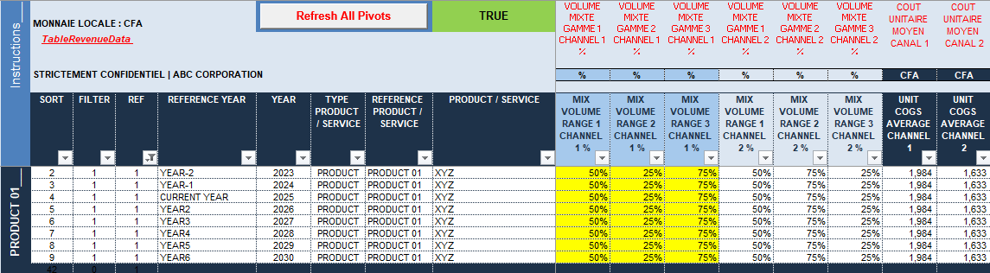
RevenueData Tab (3/4)
ONE PRODUCT - THREE RANGES - TWO CHANNELS DISTRIBUTION !!!!!!! OPTIONAL !!!!!!!
Fill the yellow cells
  MIX VOLUME RANGE 1 CHANNEL 1 % to MIX VOLUME RANGE 3 CHANNEL 1 % columns
    Product or service range volume % per distribution channel
    For each product or service range, the sum of CHANNEL 1 % and CHANNEL 2 % is always equal to one
Two Business Types
  You may serve two distribution channels : i.e. B2C and B2B
One Business Type
  If only one business type, set the selected one to 100% and the other will be set to 0%.
Training Financial Plan v02
26

Slide 27

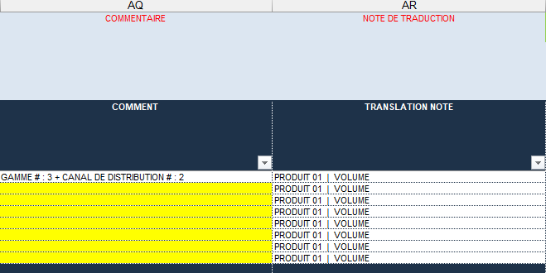
RevenueData Tab
(4/4)
Refresh All Pivots
  Click on “Refresh All Pivots” button to actualize your RevenuePivot and RevenueChart sheets
  Analyse the overall results
  Look at RevenuePivot and RevenueChart sheets
  Process iteration
  Reiterate the process of inputs entry till you are confident with your business assumptions
  Check
  The cell J1 should be equal to TRUE. Please verify your % for product and service ranges and distribution channels
  TIP
  COMMENT column (AQ:AQ) provides you an opportunity for adding a free text with your own comment
  TRANSLATION NOTE column (AR:AR) provides you a translation of REFERENCE PRODUCT / SERVICE (I:I) and ITEM (K:K) columns

Slide 28

RevenueData Tab
FAQ
The financial plan allows to record products with income that will not be taken into account in the total revenue by filtering them in the InputsData tab. Why would we want that?
It’s an option to add some specific products and to see the impact of these products on your total revenue by setting the filter to 1 or 0 in the InputsData tab.
If the entrepreneur has several different activities, how should they be named in the final plan? Product name like “Activity 1. Product A”, etc.?
You may use the product name to differentiate your activities, but you will not get any direct consolidation by activity.
It’s recommended to use the RANGE option that you can name activity 1, activity 2 and activity 3. And you pick the adequate range for each product.
If we do not have the data for previous years' income, what should we indicate?
You should know at least your total revenue and the total cost of goods sold of the previous years (from your official income statements declaration). You should have also an estimation about the total products sold.
You may define a specific product or use one defined product, and for the specific year, enter :
  UNIT SELLING PRICE RANGE 1 = Total revenue of the year / Number of products sold during the year
  MIX VOLUME RANGE 1 = 100%
  UNIT COGS RANGE 1 = Total cost of goods sold of the year / Number of products sold during the year
  QUARTER 4 = Number of products sold during the year
Proposal: add an extra sheet to show how the Cost of Goods Sold (all costs except labour costs) is calculated.
This proposal is under consideration but not yet implemented.
Time for coffee or tea

Slide 29
RevenuePivot Tab
(1/1)
PivotTables
  PivotTableRevenueData1 By quarter
  PivotTableRevenueData2 By product / service
  PivotTableRevenueData3 By product / service range
  PivotTableRevenueData4A By distribution channel
  PivotTableRevenueData4B By aggregated product / service type
  PivotTableRevenueData5 By semester

Slide 30
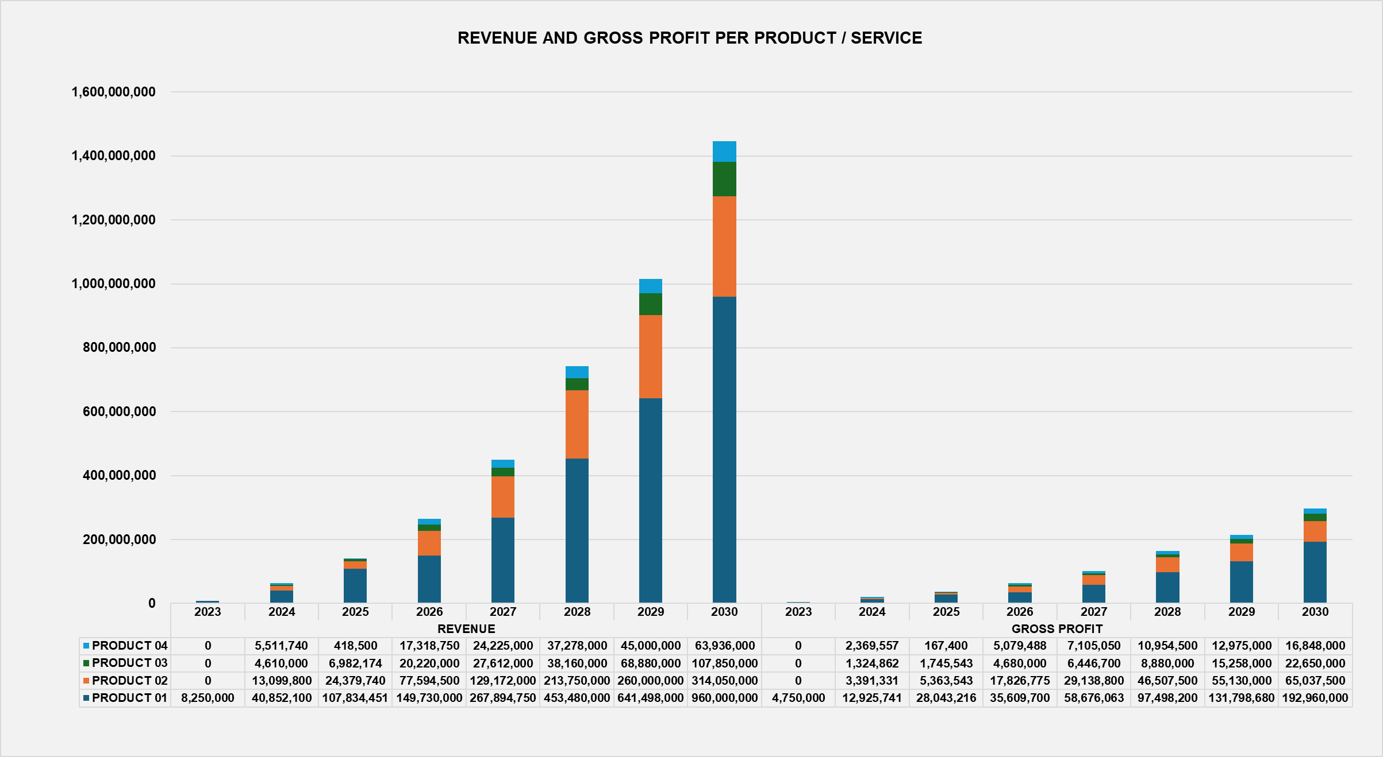
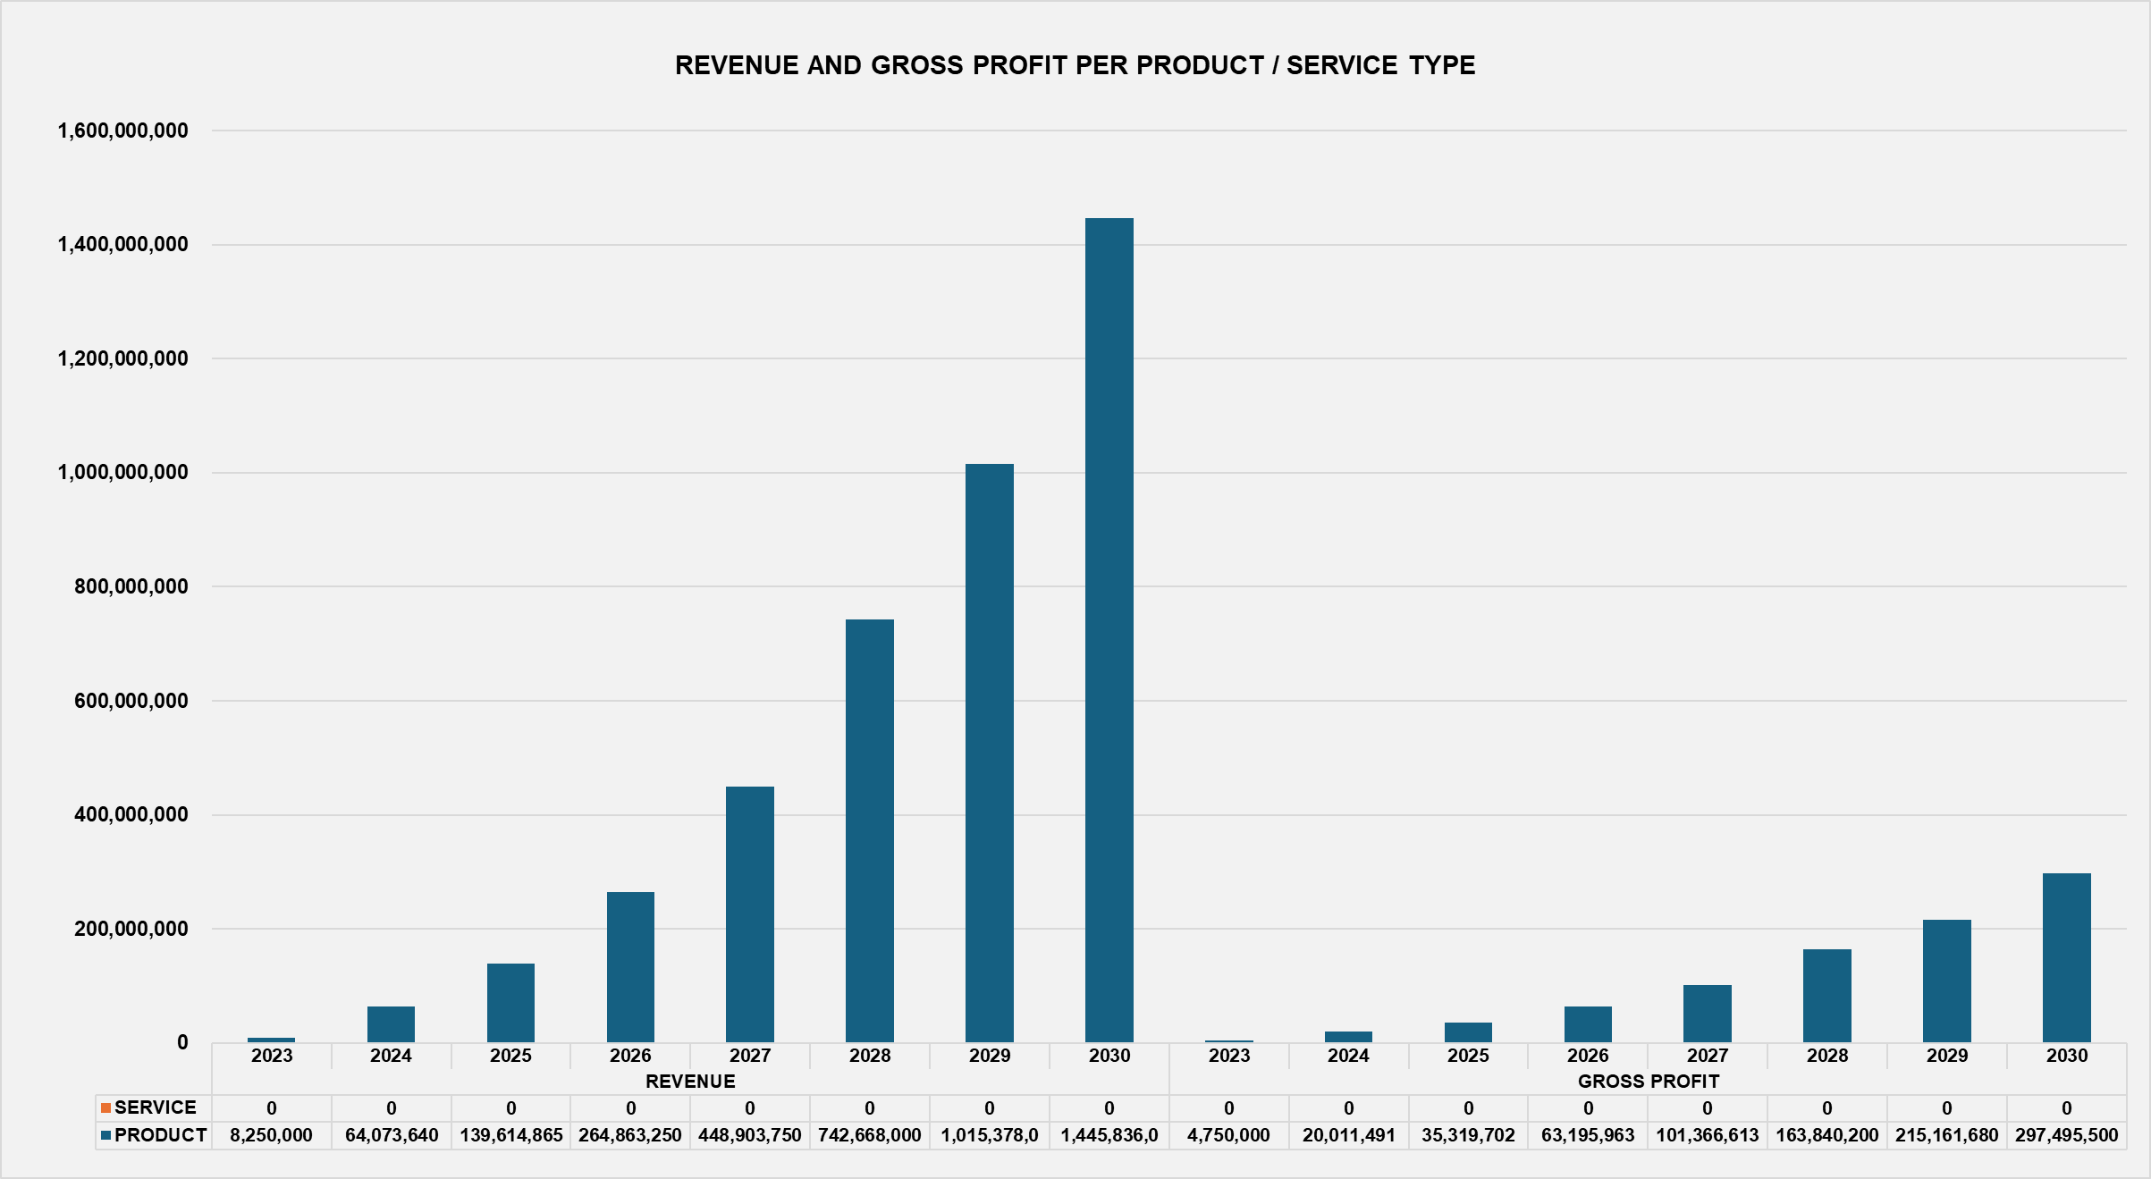
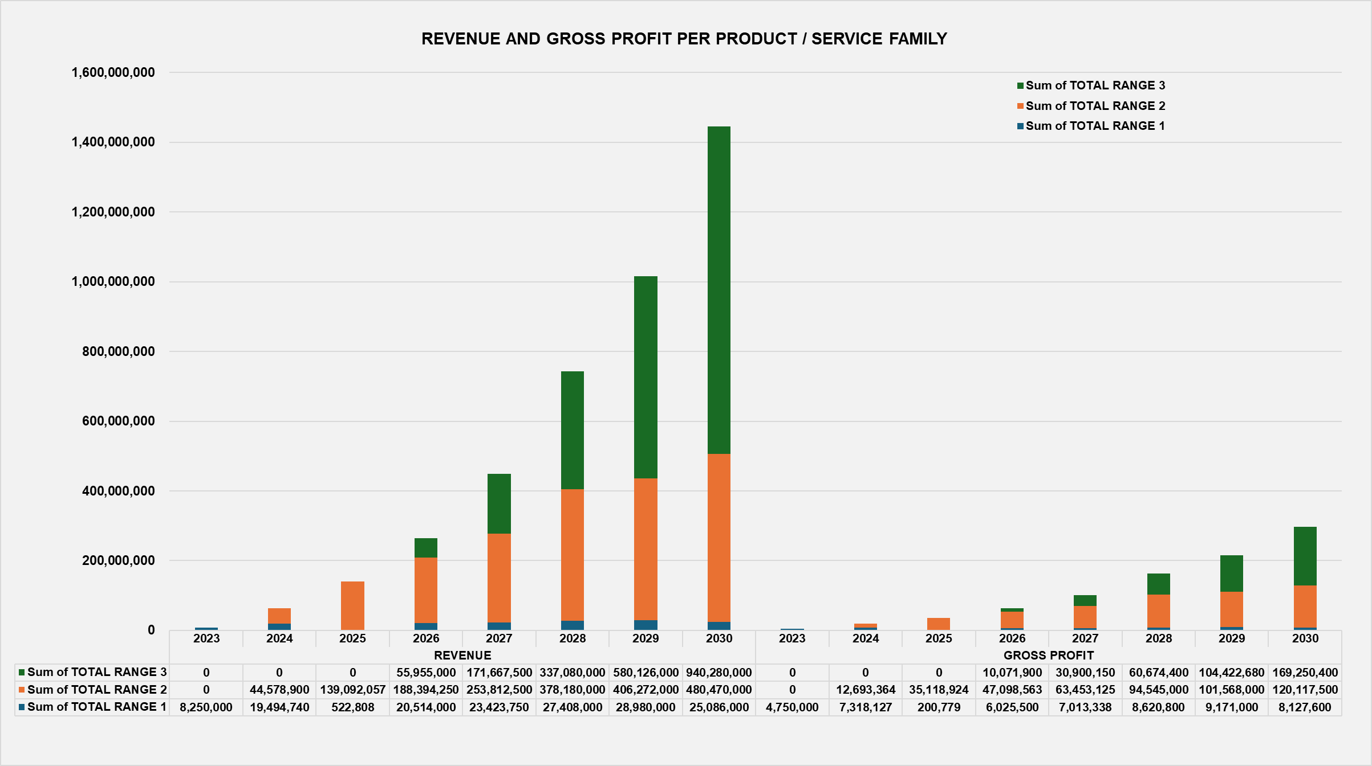
RevenueChart Tab
(1/1)
Chart
  Revenue and Gross Profit By product / service
  Revenue and Gross Profit By product / service range
  Revenue and Gross Profit By distribution channel

Slide 31

FinanceData Tab (1/8)
Inputs Gathering
  You should gather information about operating costs including salary costs, office costs, etc. and investments needed to conduct your business
  Historical data and market benchmarks help guide realistic operating expenses estimates and projections
  Section 1 is pre-filled with the results from the RevenueData sheet. No entry is requested except raw material stock increase or decrease in value.
  Jump to section 2 and start filling the yellow cells
  You have defined your staffing department in the InputData sheet
  TIP
  You may use cell C3 to filter section or use the keyboard arrow up and down in column B to navigate from one section to the next one iso scrolling the document
  COMMENT column (Y:Y) provides you an opportunity for adding a free text with your own comment
  TRANSLATION NOTE column (Z:Z) provides you a translation of ITEM (D:D), SUB-ITEM1 (E:E) and SUB-ITEM3 (G:G) columns

Slide 32
FinanceData Tab (2/8) - Section 2 : Operating Expenses
Section 2 - Operating Expenses
  9 operating expenses sub-sections to be filled
  PARAMETER columns pre-filled with inputs gathered in InputsData sheet but can be overwritten. If change, please fill COMMENT column with an explanation.
  YEAR-2, YEAR-1, CURRENT YEAR H1, CURRENT YEAR H2, YEAR 2 to YEAR6 columns to be filled in local currency except NUMBER OF EMPLOYEES in the STAFF SALARIES sub-section to be filled in EFT (Equivalent Full Time)
  DESCRIPTION1 column is pre-filled with generic expenses types but you may add your business-related expenses on the rows labelled X, Y, Z, A or B (free text)

Slide 33
FinanceData Tab (3/8) - Section 3 : Investment and Amortisation
Section 3 – Investment and Amortization
  SUB-ITEM1 - INVESTMENTS
  DESCRIPTION2, ACQUISITION YEAR, ACQUISITION VALUE, % YEARLY AMORTISATION, ACCUMULATED AMORTISATION VALUE (before YEAR-2) columns to be filled
  DESCRIPTION2 is a free text column
  SUB-ITEM1 – AMORTISATIONS
  YEAR-2 and YEAR-1 are calculated cells (based on % YEARLY AMORTISATION) but can be overwritten by an actual value if different from the calculated value.
  If you overwrite a cell, include a comment in COMMENT column (X:X)

Slide 34
FinanceData Tab (4/8) - Section 4 : Working Capital
Section 4 – Working Capital
  YEAR-2 and YEAR-1 should be extracted from actual figures
  For CURRENT YEAR, YEAR1 to YEAR6 columns, you should enter the number of days

Slide 35
FinanceData Tab (5/8) - Section 5 : Profit and Loss Statement
Section 5 – Profit and Loss Statement
  YEAR-2 and YEAR-1 should be extracted from actual figures
  For CURRENT YEAR, YEAR1 to YEAR6 columns
    SUB-ITEM1 VARIATION should be kept to zero normally
    SUB-ITEM1 BANK CARGES suggested to be a % of revenues but can be changed. Check the formula.
    SUB-ITEM TAX are based on tax regimes entered in InputsData sheet. Check the formula.

Slide 36
FinanceData Tab (6/8) – Section 6 : Cash Flow Statement
Section 6 – Cash Flow Statment
  YEAR-2 and YEAR-1 cash position at year end should be extracted from actual figures

Slide 37
FinanceData Tab (7/8) – Section 7 : Source of Financing
Section 7 – Source of Financing
  YEAR-2 and YEAR-1 should be extracted from actual figures
  SUB-ITEM1 SOURCE OF FINANCING enter loan and equity needs from CURRENT YEAR
  SUB-ITEM PRINCIPAL … automatically calculated unless you want to define grace period
  SUB-ITEM INTEREST … automatically calculated. You may change the interest rate by year.
Capital contribution by Existing Shareholders
  YEAR-2 is equity value by end of YEAR-2 and YEAR-1 is the delta change versus YEAR-1 occurred in YEAR-1. As such the sum (YEAR-2 + YEAR-1) equal the equity value by YEAR-1
  Loan
  We assume no existing loan in YEAR-2 and YEAR-1.
  Enter loan amount from CURRENT YEAR to YEAR6

Slide 38
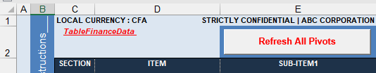
FinanceData Tab
(8/8)
Refresh All Pivots
  Click on “Refresh All Pivots” button to actualize your FinancePivot and FinanceChart sheets
  Analyse the overall results
  Look at FinancePivot and FinanceChart sheets
  Process iteration
  Reiterate the process of inputs entry till you are confident with your business assumptions

Slide 39
FinanceData Tab
FAQ
How do you deal with seasonal workers?
  Define a category seasonal workers in the InputsData tab (section 5)
  Compute the total equivalent full time (EFT) seasonal workers you contract(ed) during a year and under it under EFT
  Compute an average cost per year of one equivalent full time and enter it under GROSS SALARY
  Leave other costs and social security at zero
  xx
Time for coffee or tea

Slide 40
FinancePivot Tab
(1/2)
Profit and Loss Statement
Balance Sheet
Ratios
PivotTables
  PivotTableFinanceData1 Revenue and Gross Profit
  PivotTableFinanceData2 Volume, Average Selling Price
  PivotTableFinanceData3 Operating Expenses
  PivotTableFinanceData4 Staff
  PivotTableFinanceData5 Investments
  PivotTableFinanceData6 Working Capital
  PivotTableFinanceData7 Profit and Loss Statement
  PivotTableFinanceData8 Cash Flow Statement
  PivotTableFinanceData8 Source of Financing

Slide 41
FinancePivot Tab
(2/2)
Profit and Loss Statement
Balance Sheet
Ratios
  The RATIOS tracks financial metrics to measure performance.
PivotTables
  PivotTableFinanceData1 Revenue and Gross Profit
  PivotTableFinanceData2 Volume, Average Selling Price
  PivotTableFinanceData3 Operating Expenses
  PivotTableFinanceData4 Staff
  PivotTableFinanceData5 Investments
  PivotTableFinanceData6 Working Capital
  PivotTableFinanceData7 Profit and Loss Statement
  PivotTableFinanceData8 Cash Flow Statement
  PivotTableFinanceData8 Source of Financing

Slide 42
FinanceChart Tab
(1/4)
Chart
  Profit and Loss Statement

Slide 43
FinanceChart Tab
(2/4)
Chart
  Operating Expense

Slide 44
FinanceChart Tab
(3/4)
Chart
  Staffing Headcount

Slide 45
FinanceChart Tab
(4/4)
Chart
  Cash Flow Statment

Slide 46
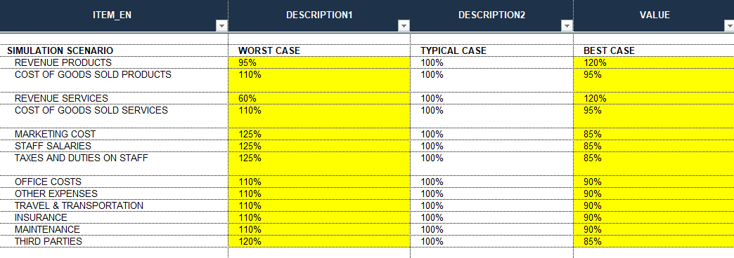
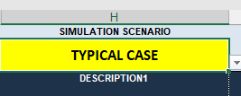
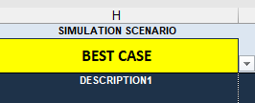
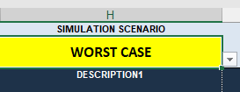
Simulation
Simulation Best-Case and Worst-Case Scenarios
  Set your parameters in the InputsData sheet
Select your Scenario
  Select your scenario in Dropbox in cell H2 of the Finance sheet
Refresh All Pivots
  Click on “Refresh All Pivots” button to actualize your FinancePivot and FinanceChart sheets
  Analyse the overall results
  Look at FinancePivot and FinanceChart sheets
  Process iteration
  Reiterate the process of inputs entry till you are confident with your business assumptions
  Do not forget to set your scenario at “TYPICAL CASE” and refresh all the pivots at the end

Slide 47
Plan Validation and Review

Slide 48

Validation and Review
Verification and Iteration
  Verify inputs in the financial plan to ensure their accuracy and relevance.
  Best Practices for accuracy : regularly updating assumptions and maintaining backup versions improve financial plan reliability.
Peer Review Importance
  Engage peer reviews to catch errors and improve the reliability and credibility of the financial plan.
Totals Check
  Check totals match in the Instructions Sheet. All checks should be TRUE

Slide 49

Exporting and Sharing
Print as PDF
  You may print some pages of the workbook
  Copy / Paste
  You may transfer some PivotTables or Charts in your business plan file
Version Control Importance
  Tracking plan changes over time ensures accuracy and accountability in updates. You may change the date of your workbook filename

Slide 50
Q&A

Slide 51

Q&A
You may shoot your questions not the pianist !!!

Slide 52
Thank You
Enjoy the spreadsheet.
Don’t worry.

Slide 53
Jean Beka

